Slide 1




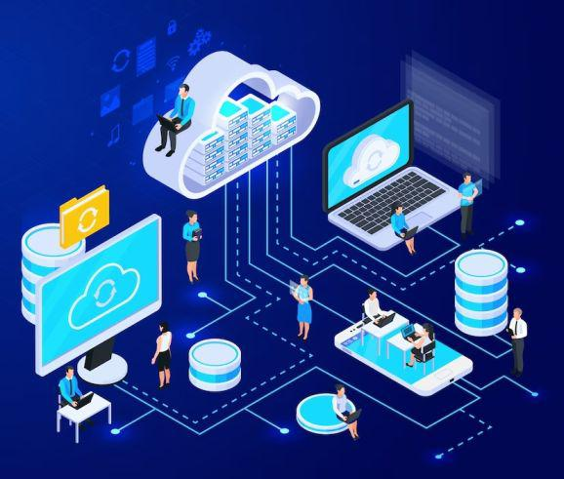



PCS-2
GROUP PROJECT

Slide 2


Project's Agenda
1
Project’s title
2
Project’s objective
3
Project Overview
4
Core concepts used
5
The team
Project working
6
The team

Slide 3

Handcricket Battles in the Networking Arena

Slide 4





OBJECTIVE
The main objective of this project is to develop a multiplayer cricket game using Python and Pygame, offering users an immersive virtual cricket experience
Through the implementation of client-server architecture, the game enables multiplayer functionality, allowing multiple users to compete.

Slide 5

Project Overview
This project is a multiplayer cricket game implemented in Python using Pygame for the user interface and socket programming for networking. Clients connect to a central server, which manages multiple game instances and facilitates communication. The server assigns player roles, tracks game state, and updates clients accordingly. The game logic, encapsulated in the CricketGame class, handles player moves, scoring, and game outcomes. The project demonstrates a basic client-server architecture for multiplayer gaming, integrating graphical interface development, networking, and game logic.

Slide 6


Core concepts used
Client-Server Architecture
Socket Programming
TCP (Transmission Control Protocol)
User Interface Design

Slide 7
connectivity between concepts and the game
In this project, computer networking concepts play a pivotal role in enabling multiplayer functionality and facilitating real-time communication between clients and the central server. The client-server architecture establishes a framework where multiple clients connect to a central server, enabling seamless multiplayer gameplay experiences. Socket programming, utilizing TCP as the underlying protocol, ensures reliable and ordered data transmission between the clients and server, maintaining game state synchronization. Pickle serialization optimizes the transmission of game data over the network, enhancing network performance. Robust error handling mechanisms are implemented to manage network issues, ensuring uninterrupted gameplay. These networking concepts collectively contribute to the smooth operation and effectiveness of the multiplayer cricket game, providing users with an immersive and engaging gaming experience.

Slide 8
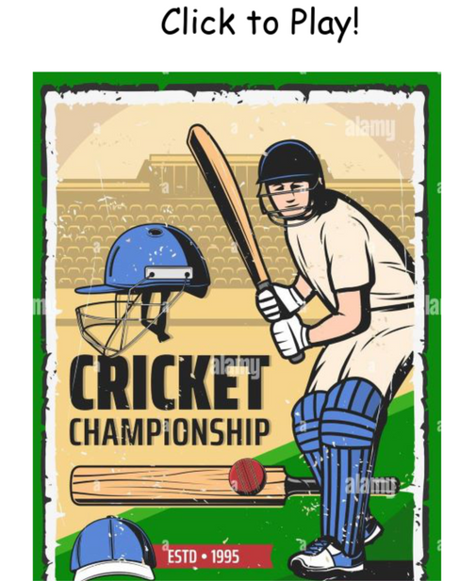
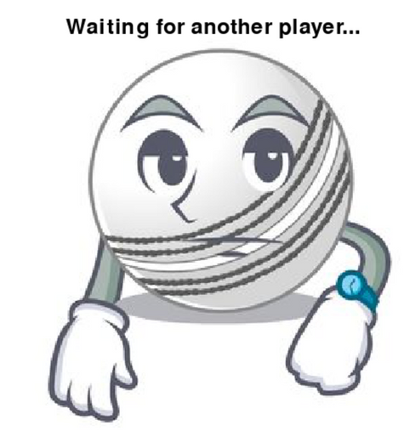
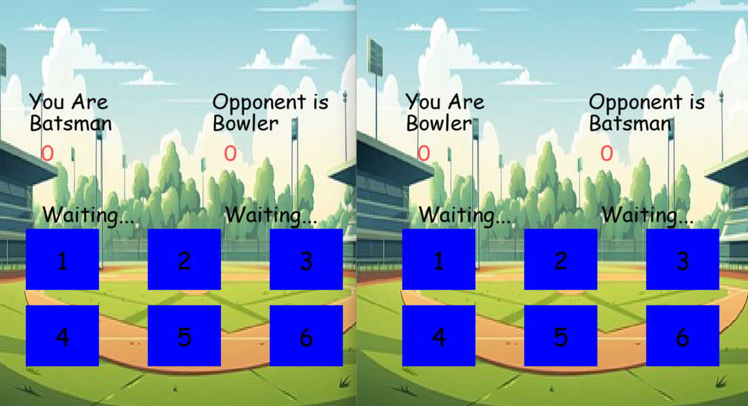
before client
connects to
server
after client1
connects to
server
after both clients
connected to
server

Slide 9
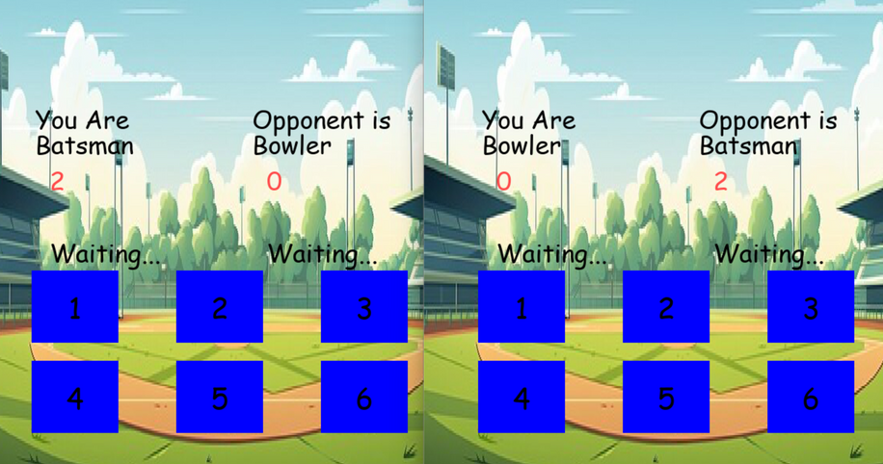
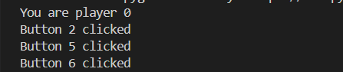
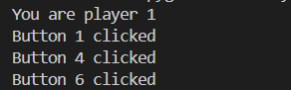
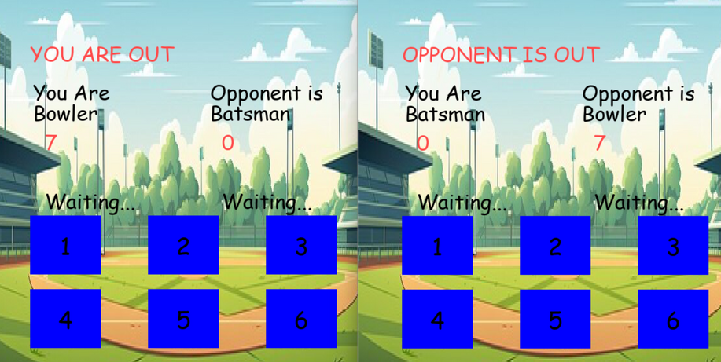
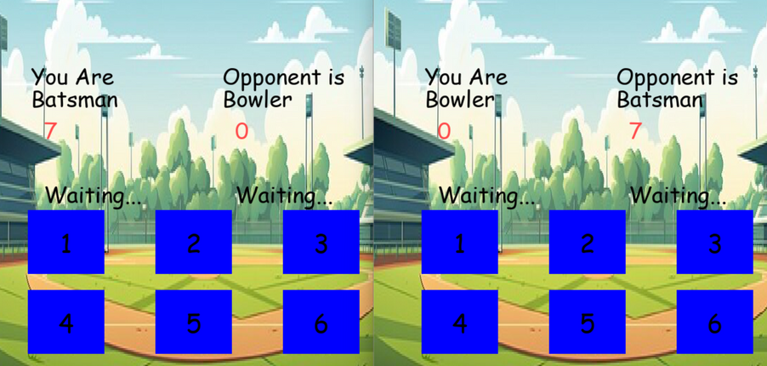
PLAYER-0
PLAYER-1
batting of player 0

Slide 10
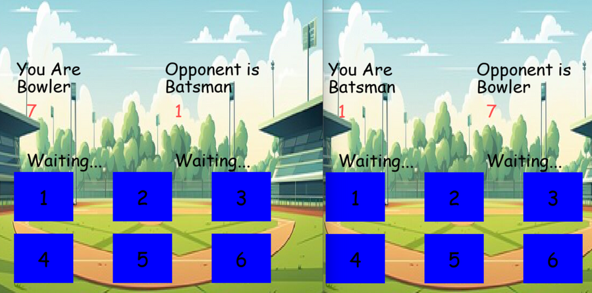

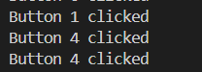
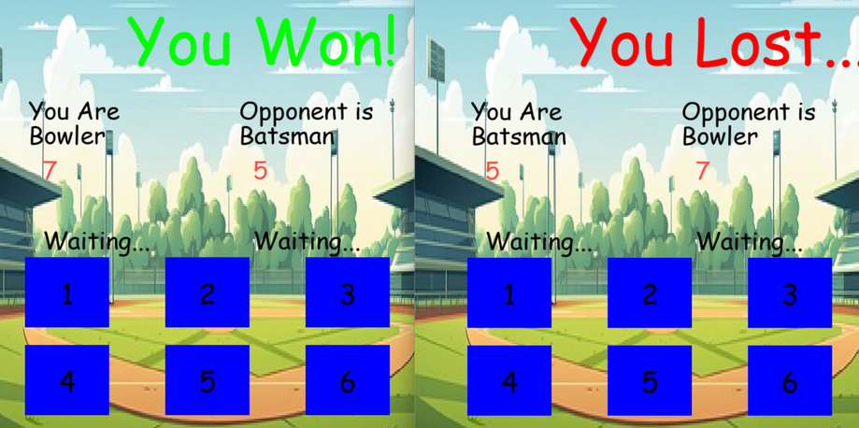
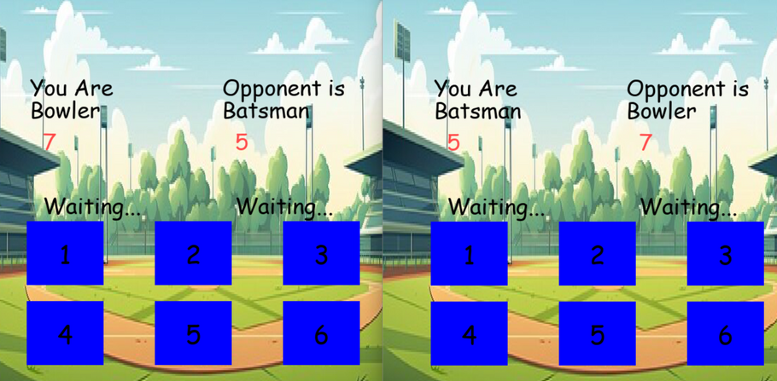
batting of player 1
PLAYER-0
PLAYER-1
player 0 clicks
player 1 clicks

Slide 11
THANK YOU
COURSE INSTRUCTOR: prof. SUMIT KALRA

Slide 12


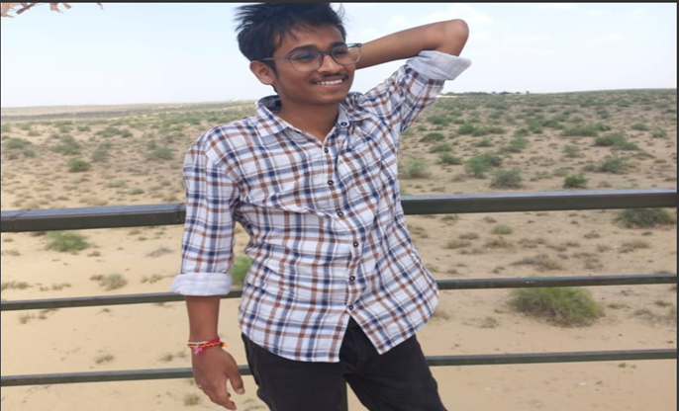

The team
karan reddy
B22AI023
Abhijan theja
B22AI025

